Slide 1
Risk Management
Subhash Paudel
MSCSKE, IOE, Pulchowk Campus
subhash@achsnepal.edu.np
Notes:
M.Sc. Computer Engineering, Computer System and Knowledge Engineering

Slide 2
What is Risk?
Risk is defined as “uncertain event or condition that, if it occurs, has a positive Or negative effect on a project’s object”
A risk is a potential problem – it might happen and it might not
Risks cannot be eliminated from a project, but luckily can be managed
Key Elements of Risk
– Risk concerns future happenings
– Risk involves change in mind, opinion, actions, places, etc.
– Risk involves choice and the uncertainty that choice entails

Slide 3
What is Risk?
Two characteristics of risk
Uncertainty – the risk may or may not happen, that is, there are no 100% risks (those, instead, are called constraints)
Loss/Benefit –
the risk becomes a reality and unwanted consequences or losses occur.
some risks present opportunities for improvement or innovation
Every project involves risk.
project risks, which prevent the project from being completed successfully, are different from the business risk that the delivered products are not profitable.

Slide 4
Types Of Software Risks
Software risk exists because the future is uncertain and there are many known and unknown things that cannot be incorporated in the project plan.
A software risk can be of two types
Internal risks
that are within the control of the project manager and
External risks
that are beyond the control of project manager.

Slide 5
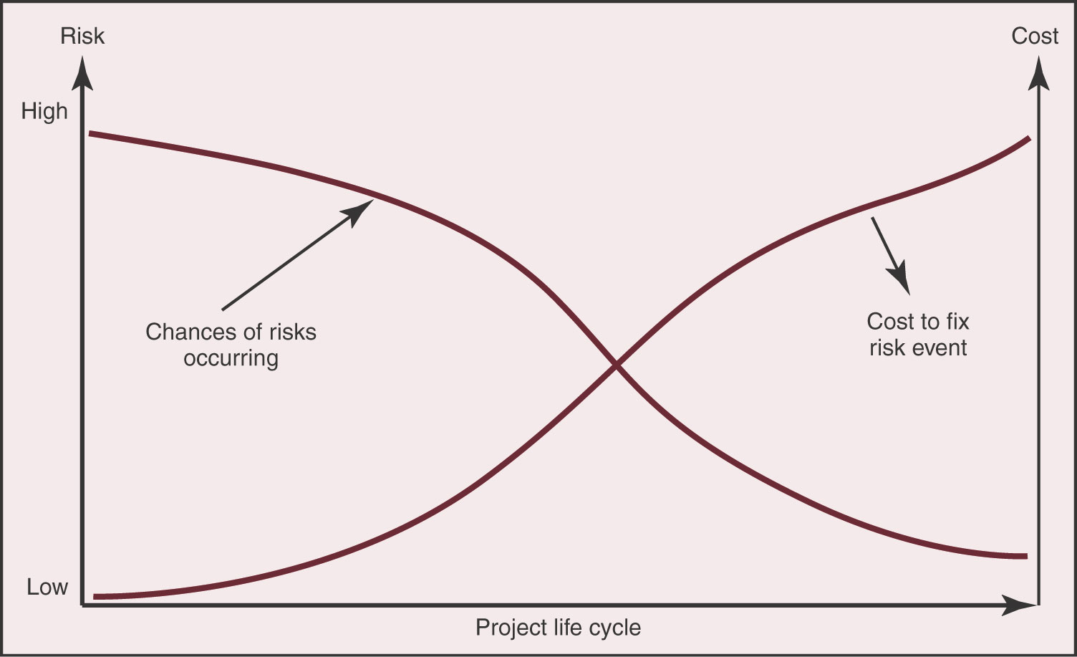
Risk During The Project

Slide 6
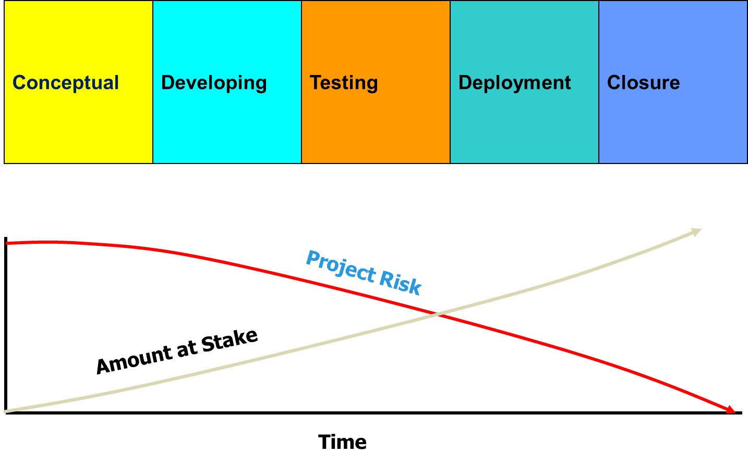
Risk and the Project Life Cycle

Slide 7
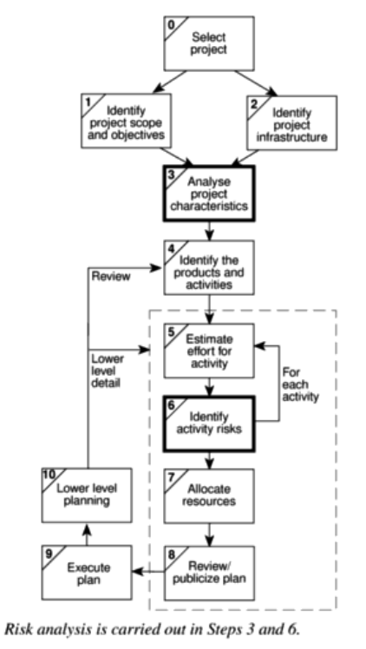

Slide 8
Nature of Project Risks
Planning assumptions
Those due to assumptions made during the planning process
Estimation errors
Those caused by the inherent difficulties of estimation
Eventualities
Those of unforeseen (or at least unplanned) events occurring

Slide 9
Planning assumptions
Why assumptions ?
Due to uncertainties in early stage of the project.
Some of the common assumption made are:
Everything will go smoothly
Environment is reliable and fixed
Design will be perfect first time
Coding will be ‘nearly perfect’
Guidelines to reduce the risk made due to assumptions:
List all the assumptions
Identify the effects of these assumptions

Slide 10
Estimation Errors
Estimation error can occur due to:
Difficult to have accurate size or time estimations due to
Lack of experience of similar tasks
Lack of historical data
Nature of the task
Estimation can be improved by analyzing historic data for similar tasks and similar projects
Keep historic data of your estimation and the actual performance
Compare your estimation and the actual value
Classify the tasks that are easy or difficult to give accurate estimation

Slide 11
Eventualities
Unexpected and unimaginable events
Common unexpected events
Hardware cannot be delivered on time
Requirements specification needs to be rewritten
Staffing problem

Slide 12
Software Risks Generation
Risk | Affects | Description
Staff Turnover | Project | Experienced staff will leave the project during development
Management Change | Project | There is a change of Organizational management with different priorities.
Hardware Unavailability | Project | Hardware that is essential for the project will not be delivered in schedule
Requirements change | Project and product | There will be large number of changes to the requirements than anticipated.

Slide 13
Software Risks Generation
Risk | Affects | Description
Technology change | Business | The underlying technology in which the system is built is superseded by new technology
Product Competition | Business | A competitive product is marketed before the system is completed.
Specification delays | Project and product | Specification of essential interfaces are not available on schedule

Slide 14
Risk Categorization
Approach 1
Project risks
Technical risks
Business risks
Approach 2
Known risks
Predictable risks
Unpredictable risks
Approach 3: Socio-technical model of risk
Actor
Technology
Structure
Tasks

Slide 15
Risk Categorization #Approach 1
Project risks
They threaten the project plan
If they become real, it is likely that the project schedule will slip and that costs will increase
Technical risks
They threaten the quality and timeliness of the software to be produced
If they become real, implementation may become difficult or impossible
Business risks
They threaten the viability of the software to be built
If they become real, they jeopardize the project or the product

Slide 16
Risk Categorization #Approach 1
Sub-categories of Business risks
Market risk – building an excellent product or system that no one really wants
Strategic risk – building a product that no longer fits into the overall business strategy for the company
Sales risk – building a product that the sales force doesn't understand how to sell
Management risk – losing the support of senior management due to a change in focus or a change in people
Budget risk – losing budgetary or personnel commitment

Slide 17
Risk Categorization #Approach 2
Known risks
Those risks that can be uncovered after careful evaluation of the project plan, the business and technical environment in which the project is being developed, and other reliable information sources (e.g., unrealistic delivery date)
Predictable risks
Those risks that are extrapolated from past project experience (e.g., past turnover)
Unpredictable risks
Those risks that can and do occur, but are extremely difficult to identify in advance

Slide 18
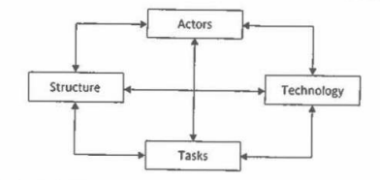
Socio-technical Model Of Risk Categorization #Approach 3
Actor:
Actor refers to all the people involved in the development of the application in question.
A typical risk in this area is that high staff turnover (left) leads to expertise of value to the project being lost.
Technology:
It encompasses both the technology used to implement the application and that embedded in the delivered products.
Risk here could relate to the appropriateness of the technologies and to possible fault within them especially when they are new.

Slide 19
Socio-technical Model Of Risk Categorization #Approach 3
Structure:
It describes the management structures and systems, including those affecting planning and control.
Risk here might be implementation might need user participation in some task but the responsibility for managing the users contribution might not be clearly allocated.
Tasks:
It relate to the work planned.
Risk in this might be the complexity of the work might lead to delays because of the additional rime required integrate the large no. of components.

Slide 20
Types Of Software Risks
Scope Risk
Scheduling Risk
Resource Risk
Technology Risk
Financial Risk
Political/ Social and Environmental Risk

Slide 21
Examples Of Software Risks
Nobody uses/likes your system -> people use workarounds/competitor
Solving the wrong problem -> no business case
It is harder than expected, unknown technical effects -> delay of delivery
The application crashes in production -> lose of customers
The database gets corrupt -> your business cannot operate anymore
Someone steals information -> privacy claim

Slide 22
Sources Of Software Risks
New technology.
Uncommon systems or methods.
Uncertain funding.
Unusual financing arrangements.
Controversial functions provided by the project.
Unrealistic completion dates and/or budgets.
Changing customer ownership/control
Unusual contracting arrangements
Project scope not clearly defined.
Project need and alternatives have not been rigorously evaluated.
Large number of approvals required.
Conflict among project participants.
Relationship between parent organization's role and the project not clear

Slide 23
Why Risk Management
Risk management is carried out to:
Identify the risk
Reduce the impact of risk
Reduce the probability or likelihood of risk
Risk monitoring
Identify the risk
Reduce the impact of risk
Reduce the probability or likelihood of risk
Risk monitoring

Slide 24
A Framework For Dealing With Risk
Steps in Risk Management
Step 1: Risk Identification
Step 2: Risk Analysis
Step 3: Risk Planning
Step 4: Risk Monitoring

Slide 25
Risk Management Process

Slide 26
Effective Risk Management
ANALYSE RISKS
IDENTIFY UNCERTAINTIES
ACCESS
MEASURE & CONTROL
CONTROL
PRIORITIZE RISKS
PLAN FOR EMERGENCIES
MITIGATE RISKS

Slide 27
Effective Risk Management
IDENTIFY UNCERTAINTIES
Explore the contract and
relationship for areas of
uncertainty
ANALYSE RISKS
Specify how each uncertainty
can impact performance -
duration, cost, meeting
requirements
PRIORITIZE RISKS
Establish risks to be eliminated (too severe), requiring committed management attention, minor in effect
MITIGATE RISKS
Take advance action to
reduce effect. It is better to
spend on mitigation than to
include contingency.
PLAN FOR EMERGENCIES
For all significant risks, have
an emergency plan in place.
MEASURE AND CONTROL
Track the effects of the risks
identified and manage to a
successful conclusion.

Slide 28
Step 1:Risk Identification
The categories of factors that will need to be considered in risk identification include the following:
Application factors – Nature of application (Software) – simple or complex.
Staff factors – include factors like experienced, unexperienced etc.
Project factors
Project methods
Hardware/Software factors
Changeover factors
Supplier factors
Environment factors
Health & safety factors

Slide 29
Step 1:Risk Identification
Two main approaches for identification of risks are
Check-List
Brain-Storming.

Slide 30
Step 1:Risk Identification Check-List
Check-Lists
are simply list of the risks that have been found to occur regularly in software development projects.
Ideally a group of representative project stakeholders examines a checklist identifying risks applicable to their project.
Often the checklist suggests potential counter measures for each risk.

Slide 31
Step 1:Risk Identification Brain-Storming
Brain-Storming
In this method representatives of the main stakeholders should be brought together once some kind of preliminary plan has been drafted.
They then identify, using their individual knowledge of different parts of the project, the problems that might occur.

Slide 32
Step 2: Risk Analysis
Qualitative allows for risks to be quickly categorized and ready for comparison
May give a lot of discussion between stakeholders
‘Uncountable’ aspects have value, like aesthetics, emotions, though hard to explain in scientific and business language
Results of qualitative risk analysis
Ranking or prioritization of project risks.
Updated risk register.
Risks identified for further/quantitative analysis.

Slide 33
Step 2: Risk Analysis
Quantitative ensures risks are fully understood
Reduce discussion as you must understand the risk in every detail in order to generate valid metrics
Expensive to obtain (i.e. very time consuming to obtain data)
Conducted using various quantitative techniques
Probability distributions
Expected value analysis
Decision tree analysis
Results of quantitative risk analysis
Updated risk register.
Updated prioritized risks.
Updates to Risk Management Plan
Updates to Project Management Plan.

Slide 34
Step 2: Risk Analysis
No. of risks is potentially endless, which is a problem in risk management. So a way is needed of distinguishing the damaging and likely risks. This can be done by estimating the risk exposure for each risk using the formula:
Risk exposure= (potential damage) X (probability of occurrence)
Risk exposure = (Risk impact) x (Risk likelihood)
Risk exposure is expressed in term of money value.
The calculation of risk exposure assumes that the amount of damage sustained will always be the same.

Slide 35
Step 2: Risk Analysis
Example: supposed a project depended on a data center vulnerable to fire. It might be estimated that if a fire occurred a new computer configuration could be established for $500,000. It might also be estimated that where the computer is located there is a 1 in 1000 chances of a fire actually happening that is a probability of 0.001.
The risk exposure in this case would be:
$500,000 x 0.001=$500
With some there could be not be only damage but also gains.
Based on the risk exposure of the risk they should be ranked based on the potential damaged caused by them.

Slide 36
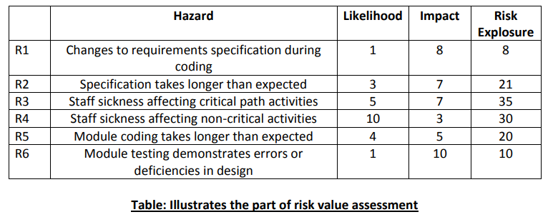
Step 2: Risk Analysis
The risk exposure allows us to obtain an approximate ranking in order of importance considering above table, R3 and R4 are, clearly the most important and we could classify them as being high risk concerns. R2 and R5 have similar scores and might be thought of as medium priority risks. The two remaining risks, R1 and R6 have quite low exposure values and can therefore classified as low risks items.

Slide 37
Step 2: Risk Analysis
Risk Matrix
 | LOW
 | Medium
 | High

Slide 38
Step 3: Risk Planning
Once the major risks are identified and allocated the priorities, the task is to decide how to deal with them .
Managing risk involves the use of two strategies:
Reducing the risk exposure by reducing the likelihood or impact.
Drawing up contingency plans to deal with risk that could occur.

Slide 39
Step 3: Risk Planning
The choice may be:
Risk acceptance
Risk avoidance
Risk reduction and mitigation
Risk transfer
Contingency planning

Slide 40
Step 3: Risk Planning
Risk Acceptance
This is do-nothing option. Here in the risk prioritization process have decided to ignore some risks order to concentrate on the more likely or damaging.
We choice this option for those risks whose damage would be less than the cost of action that might reduce the risk happening
Risk Avoidance
Some activities may be prone to accident that it is best to avoid them.
For example, if we are worried about the shark then don’t go into the water.
In software development if we identify that most risk occur by developing from scratch then manager might decide to retain existing methods or to buy-off-the –shelf solution.

Slide 41
Step 3: Risk Planning
Risk Reduction and Mitigation
In this option we decide to go ahead with a course of action despite the risks but take precautions that reduce the probability of the risk.
Risk reduction attempts to reduce the likelihood of the risk occurring.
Risk mitigation is action taken to ensure that the impact to the risk is lessened when it occurs. For example, taking regular back up of data storage
Risk Transfer
In this option the risk is transferred to another person or organization
An example of this would be where a software development task is outsourced to an outside agency for a fixed fee.
You might expect the supplier to quote a higher figure to cover the risk that the project takes longer than the 'average' expected time.

Slide 42
Step 3: Risk Planning
Contingency Planning
Risks associated with the technical aspects of a project can have the most sever outcomes
Can be mitigated by building and testing prototypes of critical components
Have available backup or alternate designs that have much lower risk
Risks associated with the schedule usually require a trade-off
Manage “slack” time to provide resources for delayed components
Bring in more people (increase costs) or reduce performance
Risks associated with costs usually result from estimate errors and omissions
Time & cost are related; trade-off schedule delays with lower cost
“Descope” options that remove components of the project, but still allow the primary mission to proceed
All “budgets” (mass, power, schedule, cost) should include a reserve percentage that can be expended as risk events occur

Slide 43
Step 4: Risk Monitoring
Involves executing the risk management process to respond to risk events
Track the status of each risk
Respond to triggers, symptoms and indicators of actual risk events
This is an ongoing activity – new risks will be identified, old risks disappear, weaken or get stronger
Workarounds are unplanned responses to risk events that must be done when there are no contingency plans
Main outputs of risks monitoring and control are:
Requested changes
Recommend corrective and preventive actions
Updates to the risk register, project management plan

Slide 44
Step 4: Risk Monitoring
Program reviews
Earned value reporting
Critical path assessments
Risk monitoring assignments
Feedback loop

